Slide 1
Relational Algebra

Slide 2
Objectives
Introduction to Relational Algebra +
Relational Algebra Operations +
Summary +
Example Queries +

Slide 3
- Introduction To Relational Algebra ...
Relational algebra is a set of operations that enable the user to specify basic retrieval requests. Each operation produces results which is a relation.
Relational algebra expression is a sequence of relational algebra operations whose result will also be a relation.
There are two groups of relational algebra operations:
Operations developed specifically for relational database, such as SELECT, PROJECT, and JOIN.
Operations from mathematical set theory, such as UNION, SET DIFFERENCE, INTERSECTION, CARTESIAN PRODUCT, and DIVISION

Slide 4
… - Introduction To Relational Algebra
Set theoretic operations are used to merge the tuples of two relations. These are binary operations.
Some set theoretic operations require both relations must be union compatible.
Union compatible relations should have the same degree and each pair of corresponding attribute should have the same domain. These include:
UNION
SET DIFFERENCE
INTERSECTION
CARTESIAN PRODUCT is another set theoretic operation which doesn’t require union compatibility.

Slide 5
- Relational Algebra Operations
Select +
Project +
Rename +
Union +
Difference +
Intersection +
Division +
Assignment +
Cartesian Product +
Join +
Outer Union +
Composition of Operators +
Aggregate Functions +
Null Values +

Slide 6
-- Select Operation
SELECT operation is used to select a subset of the tuples from the relation that satisfies the select condition.
It is denoted by: σ _{p}(r)
p is called the selection predicate (SELECT condition)
Defined as:
σ_{p}(r) = {t | t ∈ r and p(t)}
Where p is a formula in propositional calculus consisting of terms connected by : ∧ (and), ∨ (or), ¬ (not) Each term is one of:
<attribute> op <attribute> or <constant>
where op is one of: =, ≠, >, ≥, <, ≤
Example of selection: T= σ _{name=“Adil”} (EMPLOYEE)
Notes:
Select symbol is called ‘sigma’

Slide 7
--- Select Operation – Example
A
B
C
D
α
α
β
β
α
β
β
β
1
5
12
23
7
7
3
10
X=σ_{A=B ^ D > 5} (r)
r

Slide 8
--- Select Operation – Example
A
B
C
D
A
B
C
D
α
α
β
β
α
β
β
β
1
5
12
23
7
7
3
10
X=σ_{A=B ^ D > 5} (r)
α
β
α
β
1
23
7
10
x
r

Slide 9
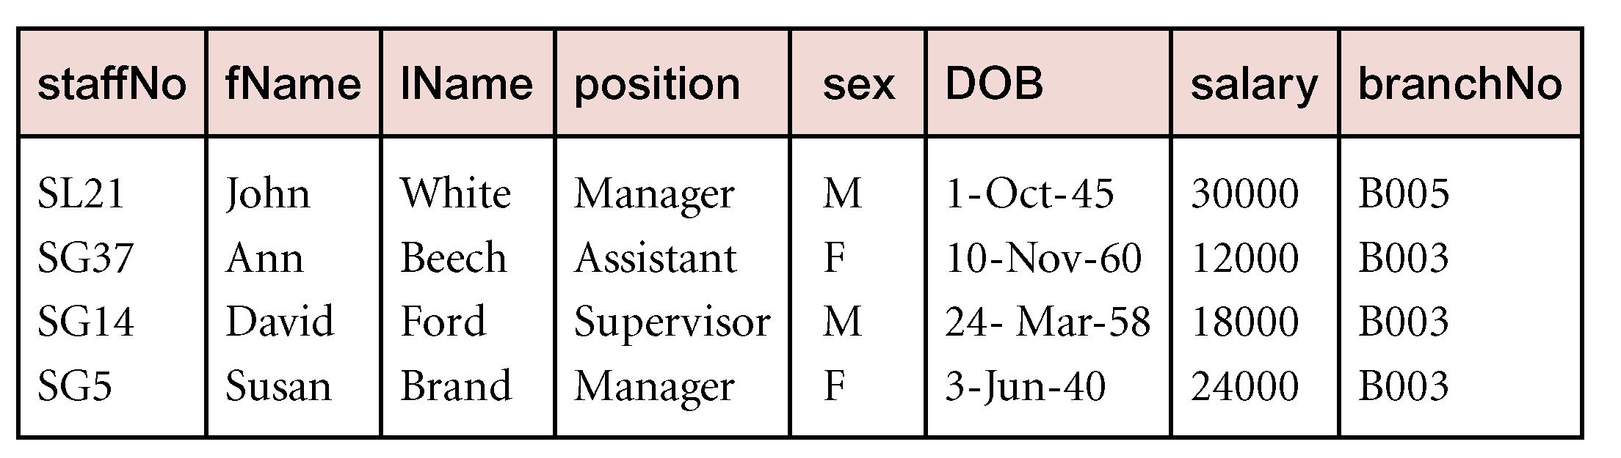
Another Example
List all staff with a salary greater than £10,000.
σ_{salary > 10000} (Staff)

Slide 10
--- Characteristics of SELECT Operation
The select condition is applied independently to each tuple t in r. If the condition is true, then tuple t is selected and will appear in the resulting relation.
The SELECT operation is unary, it is applied to a single relation.
The degree of resulting relation is the same as r.
The cardinality of resulting relation is less than or equal to r.
The SELECT operation is cumulative. A sequence of SELECT operations can be applied in any order.
σ<cond1>(σ<cond2> (r)) = σ<cond2>(σ <cond1>(r))
A cascade of SELECT operations can be combined into a single SELECT operation with a conjunctive (^) condition.
σ<cond1>(…(σ<condn> (r)) = σ<cond1>^<cond2> …<condn>(r)

Slide 11
-- Project Operation
Is used to select some attributes from a relation.
Is denoted by:
∏<attribute list>(r)
where <attribute list> are attribute names and r is a relation algebra expression
The result is defined as the relation of <attribute list> columns obtained by erasing the columns that are not listed
Example: To eliminate the name attribute of DEPARTMENT
R = ∏_{number} (DEPARTMENT)

Slide 12
--- Project Operation – Example
A
B
C
α
α
β
β
10
20
30
40
1
1
1
2
R = ∏_{A,C} (r)
r
Notes:
In a relational model, relationships are sets of tuples that, by definition, do not contain "duplicate" records.

Slide 13
--- Project Operation – Example
A
B
C
A
C
α
α
β
β
10
20
30
40
1
1
1
2
α
β
β
1
1
2
R = ∏_{A,C} (r)
R
r
Duplicates Removed
Notes:
In a relational model, relationships are sets of tuples that, by definition, do not contain "duplicate" records.

Slide 14
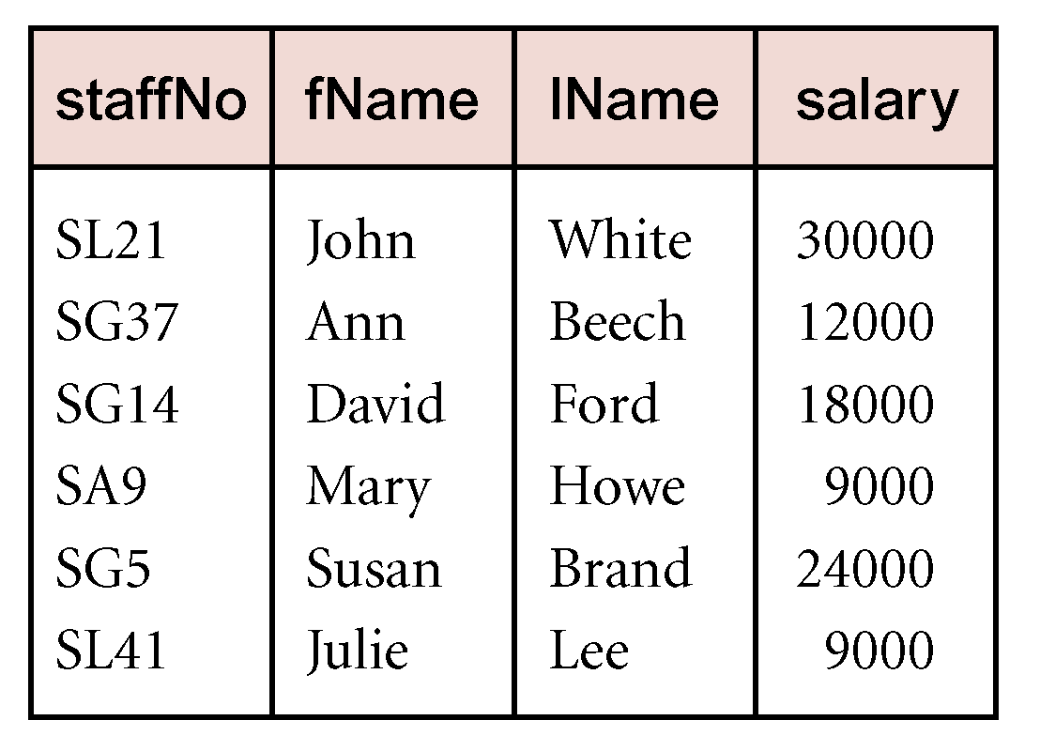
AnotherExample
Produce a list of salaries for all staff, showing only staffNo, fName, lName, and salary details.
Π_{staffNo, fName, lName, salary}(Staff)

Slide 15
--- Characteristics of PROJECT Operation
The result of a PROJECT operation will be a relation consisting of the attributes specified in the <attribute list> in the same order.
The degree is equal to the number of attributes in the list.
The projection operations removes any duplicates.
The cardinality of the resulting relation is always less than or equal to the cardinality of r.
For a cascade of PROJECT operations, only the outermost need to be considered for evaluation. If <list1> ⊆ <list2> ⊆ … ⊆ <listn> ⊆ r, then
∏<list1>(∏<list2>(… (∏<listn>(r))) = ∏<list1>(r)

Slide 16
-- Composition of Operation – Example
∏_{A,C} (σA=B ^ D > 5(r))
A
B
C
D
α
α
β
β
α
β
β
β
1
5
12
23
7
7
3
10
r

Slide 17
-- Composition of Operation – Example
∏_{A,C} (σA=B ^ D > 5(r))
A
B
C
D
σ_{A=B ^ D > 5} (r)
α
β
α
β
1
23
7
10
A
B
C
D
α
α
β
β
α
β
β
β
1
5
12
23
7
7
3
10
r

Slide 18
-- Composition of Operation – Example
∏_{A,C} (σA=B ^ D > 5(r))
A
B
C
D
σ_{A=B ^ D > 5} (r)
α
β
α
β
1
23
7
10
A
B
C
D
∏A,C( )
α
α
β
β
α
β
β
β
1
5
12
23
7
7
3
10
A
C
r
α
β
1
23

Slide 19
Four Possible ways for Select and Project
Result=σ (emp)
Result = σ _{city = “Princeton”} (emp)
Result = ∏ _{name, street} (emp )
Result = ∏ _{name, street} (σ _{city = “Princeton”} (emp) )

Slide 20
-- Rename Operation
The rename operation (ρ ) allows us to name, and therefore to refer to, the results of relational-algebra expressions.
Allows us to refer to a relation by more than one name.
Example:
ρ _{s} (r)
returns the expression r under the name s
If a relational-algebra expression r has arity n, then
ρ_{s} _{(A1, A2, …, An)} (r)
returns the result of expression r under the name s, and with the
attributes renamed to A1, A2, …., An.
Notes:
Rename or alias

Slide 21
--- Rename Operations: Example
s
A
B
C
α
α
α
a
a
a
α
γ
γ
ρ
(r)
r
A
B
C
s
ρ
(s)
α
α
α
a
a
a
α
γ
γ
A←D,
B←E,
C←F
ρ
(r)
s(D, E, F )
s
D
E
F
α
α
α
a
a
a
α
γ
γ

Slide 22
-- Union Operation
Is denoted by: r ∪ s
Is defined as:
r ∪ s = {t | t ∈ r or t ∈ s}
The result of r ∪ s will include all tuples which are either in r or in s or in both.
For r ∪ s to be valid r and s must be union compatible
Union operation is:
Commutative: r ∪ s = s ∪ r
Associative: r ∪ (s ∪ w) = (r ∪ s) ∪ w
E.g. to find all the names of faculty and students in the FACULTY and STUDENT tables: ∏_{name} (FACULTY) ∪ ∏_{name} (STUDENT)

Slide 23
--- Union Operation – Example
A
B
A
B
A
B
α
α
β
1
2
1
α
β
2
3
α
α
β
β
1
2
1
3
σ( r ∪ s)
s
r
No Duplicates

Slide 24
-- Set Difference Operation
Is denoted by: r – s
IS defined as: r – s = {t | t ∈ r and t ∉ s}
The result of r – s will include all the tuples that are in r but not in s. (Taking out all elements of 2nd set out of 1st set)
r and s must be union compatible
this operation is neither Commutative nor Associative.

Slide 25
--- Set Difference Operation – Example
A
B
A
B
A
B
α
α
β
1
2
1
α
β
2
3
σ (r – s)
α
β
1
1
s
r

Slide 26
-- Set-Intersection Operation
Is denoted by: r ∩ s
Is defined as: r ∩ s ={ t | t ∈ r and t ∈ s }
The result of r ∩ s will include all the tuples that are in both r and s.
r and s must be union compatible.
Intersection is:
Commutative: r ∩ s = s ∩ r
Associative: r ∩ (s ∩ w) = (r ∩ s) ∩ w
How to state Set-Intersection in terms of Set-Difference
r ∩ s = r - (r - s)

Slide 27
--- Set-Intersection Operation - Example
A B
A B
A B
σ (r ∩ s)
α
α
β
1
2
1
α
β
2
3
α 2
s
r

Slide 28
-- Division Operation …
Is denoted by: r ÷ s
Suited to queries that include the phrase “for all” or “for every”
Example: Show Names of students who are registered in all/every course
Let r and s be relations on schemas R and S respectively where
R = (A₁, …, A_{m}, B₁, …, B_{n})
S = (B₁, …, B_{n})
The result of r ÷ s is a relation on schema R – S = (A₁, …, A_{m})
r ÷ s = { t | t ∈ ∏ _{R-S}(r) ∧ ∀ u ∈ s ( tu ∈ r ) }

Slide 29
--- Division Operation – Example1
A
B
B
A
α
α
α
β
γ
δ
δ
δ
∈
∈
β
1
2
3
1
1
1
3
4
6
1
2
1
2
σ (r ÷ s)
α
β
s
r ÷ s = { t | t ∈ ∏ _{R-S}(r) ∧ ∀ u ∈ s ( tu ∈ r ) }
Result is those values from r which are completely divided
by both values of s
Example: Show Names of students who are registered in all/every course
Explanation: Let r shows student names and course names where s contains
course names. Then α and β is those students who are enrolled in both the
courses 1 and 2.
r
Notes:
For all B, same value of A is the result

Slide 30
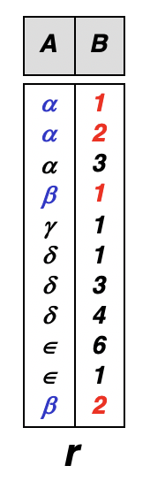
… -- Division Operation: step by step - 1
Lets Solve it using the example: Show Names of students who are registered in all course
Step 1: Compute that all the students are enrolled in all the courses
r ÷ s = ∏_{R-S} (r) –∏_{R-S} ( (∏_{R-S} (r) x s) – σ(r))
Step1A: ∏_{R-S} (r)
∏_{R-S} (r)
A
α
β
γ
δ
ε

Slide 31
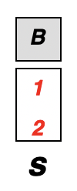
… -- Division Operation: step by step - 1
Lets Solve it using the example: Show Names of students who are registered in all course
Step 1: Compute that all the students are enrolled in all the courses
r ÷ s = ∏_{R-S} (r) –∏_{R-S} ( (∏_{R-S} (r) x s) – σ(r))
Step1B: ∏_{R-S} (r) x s
A
α
β
γ
δ
ε
α, 1
α, 2
β,1
β, 2
γ,1
γ,2
δ,1
δ,2
∈,1
∈,2
∏_{R-S} (r)

Slide 32
… -- Division Operation: step by step - 1
Lets Solve it using the example: Show Names of students who are registered in all course
Step 1: Compute that all the students are enrolled in all the courses
r ÷ s = ∏_{R-S} (r) –∏_{R-S} ( (∏_{R-S} (r) x s) – σ(r))
--- ∏_{R-S} (r) x s
α, 1
α, 2
β,1
β, 2
γ,1
γ,2
δ,1
δ,2
∈,1
∈,2

Slide 33
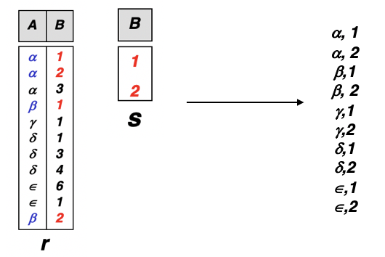
… -- Division Operation: step by step - 2
r ÷ s = ∏_{R-S} (r) –∏_{R-S} ( (∏_{R-S} (r) x s) – σ(r))
(∏_{R-S} (r) x s) – σ(r)
Step 2: Compute that “actually” which student is enrolled in which course ?
α, 1
α, 2
α, 3
β, 1
γ, 1
δ, 1
δ, 3
δ, 4
∈, 6
∈, 1
β, 2
(1)
α, 1
α, 2
β,1
β, 2
γ, 1
γ, 2
δ, 1
δ, 2
∈, 1
∈, 2
–
=
γ, 2
δ, 2
∈, 2
(2)
Disqualified tuples

Slide 34
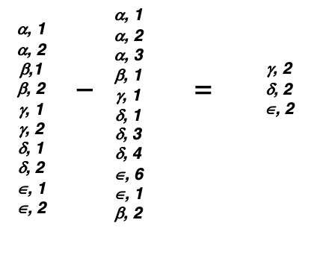
… -- Division Operation: step by step - 3
r ÷ s = ∏_{R-S} (r) –∏_{R-S} ( (∏_{R-S} (r) x s) – σ(r))
∏_{R-S} ((∏_{R-S} (r) x s) – σ(r))
Step 3: Compute only course names i.e. get the only those columns which are in R but not in S from the obtained output of Step 2
(1)
(2)
Disqualified tuples
(3)
γ
δ
∈
these are the students who are not registered in at least 1 course

Slide 35
… -- Division Operation: step by step - 4
r ÷ s = ∏_{R-S} (r) – ∏_{R-S} ((∏_{R-S} (r) x s) – σ(r))
Step 4: Distinguish those students against the ones computed in previous step i.e. those are not registered in at-least 1 course (total students – those of step 3)
(2)
γ
δ
∈
(1)
(3)
α
β
γ
δ
∈
γ
δ
∈
A
(4)
–
=
α
β

Slide 36
--- Division Operations: Example 2
D
E
A
B
C
σ (r ÷ s)
A
B
C
D
E
a
b
1
1
α
γ
a
a
γ
γ
α
α
α
β
β
γ
γ
γ
a
a
a
a
a
a
a
a
α
γ
γ
γ
γ
γ
γ
β
a
a
b
a
b
a
b
b
1
1
1
1
3
1
1
1
s
List of departments (deptno) that contains job titles for all Clerk, Salesman, Manager (scott.emp Schema).
Output:
Deptno
-------
30
r
r ÷ s = { t | t ∈ ∏ _{R-S}(r) ∧ ∀ u ∈ s ( tu ∈ r ) }

Slide 37
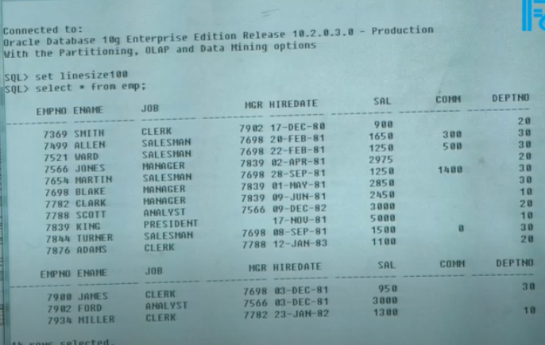
--- Division Operations: Example 2
A
B
C
D
E
D
E
A
B
C
σ (r ÷ s)
α
α
α
β
β
γ
γ
γ
a
a
a
a
a
a
a
a
α
γ
γ
γ
γ
γ
γ
β
a
a
b
a
b
a
b
b
1
1
1
1
3
1
1
1
a
b
1
1
α
γ
a
a
γ
γ
s
List of departments (deptno) that contains job titles for all Clerk, Salesman, Manager (scott.emp Schema).
Output:
Deptno
-------
30
r

Slide 38
-- Assignment Operation
The assignment operation (←) provides a convenient way to express complex queries.
Write query as a sequential program consisting of
a series of assignments
followed by an expression whose value is displayed as a result of the query.
Assignment must always be made to a temporary relation variable.
Example: Write r ÷ s as
temp1 ← ∏_{R-S} (r) temp2 ← ∏_{R-S} ((temp1 x s) – σ (r)) result = temp1 – temp2
The result to the right of the ← is assigned to the relation variable on the left of the ←
May use variable in subsequent expressions.

Slide 39
--- Assignment Operation – Example
A
B
C
A
C
α
α
β
β
10
20
30
40
1
1
1
2
α
β
β
1
1
2
Temp1 ← ∏_{A,C} (r)
Temp1
r
Notes:
Temp1 can be treated as a table, or back arrow means record is inserted into Temp1 table already created

Slide 40
-- Cartesian-Product Operation
Is denoted by: r x s
Is defined as:
r x s = {t q | t ∈ r and q ∈ s}
The result of r x s will combine tuples from both r and s in a combinatorial fashion.
Assume that attributes of r(A) and s(B) are disjoint. (That is, A ∩ B = ∅).
If attributes of r(A) and s(B) are not disjoint, then renaming must be used.

Slide 41
--- Cartesian-Product Operation-Example
A
B
C
D
E
A
B
C
D
E
α
β
1
2
α
β
β
γ
10
10
20
10
a
a
b
b
σ (r x s)
α
α
α
α
β
β
β
β
1
1
1
1
2
2
2
2
α
β
β
γ
α
β
β
γ
10
10
20
10
10
10
20
10
a
a
b
b
a
a
b
b
r
s

Slide 42
--- Characteristics of Cartesian-Product Operation
Degree r X s = degree(r) + degree(s)
Cardinality of r X s = cardinality(r) * cardinality(s)
Generally the result of CARTESIAN PRODUCT is meaningless unless is used with other operators like SELECT, PROJECT etc

Slide 43
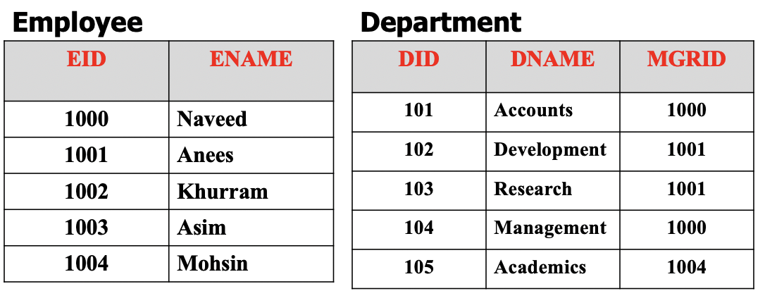
Application of Cartesian-Product Operation
Problem: Show e-name and d-name of that employee who is manager of “Accounts” department
Step 1: Take cross product of Employee and Department relations
r x s

Slide 44
Application of Cartesian-Product Operation
Problem: Show e-name and d-name of that employee who is manager of “Accounts” department
Step 2: Perform “selection” operation on output of previous step with according predicates

Slide 45
Application of Cartesian-Product Operation
Problem: Show e-name and d-name of that employee who is manager of “Accounts” department
Step 3: Perform “projection” operation on output of previous step to get only e-name and d-name

Slide 46
-- JOIN
Join Operation combine related tuples from two relations into a single tuple based on join condition.
Its is denoted by: r <join condition>s

Slide 47
JOIN Operation Example(1)
Consider employee and department relations of an organization
Employee
Department
EID | ENAME
1000 | Naveed
1001 | Anees
1002 | Khurram
1003 | Asim
1004 | Mohsin
DID | DNAME | MGRID
101 | Accounts | 1000
102 | Development | 1001
103 | Research | 1001
104 | Management | 1000
105 | Academics | 1004

Slide 48
JOIN Operation Example(2)
Now suppose we want to retrieve the name of manager of each department
We need to combine each department tuple with the employee tuple whose EID matches with the MGRID in department tuple

Slide 49
JOIN Operation Example(3)
We can do it in two ways
(1) We can simply use cartesian product first and then project required attributes

Slide 50
JOIN Operation Example(4)
We can do it in two ways
(2) We can use JOIN operation (More common way)

Slide 51
JOIN Operation Example(5)
Result of both methods will be:
Result
DID | DNAME | MGRNAME
101 | Accounts | Naveed
102 | Development | Anees
103 | Research | Anees
104 | Management | Naveed
105 | Academics | Mohsin

Slide 52
--- Characteristic of the Join Operation
Degree of the r s = degree(r) + degree(s).
Cardinality of r s is between 0 and cardinality (r) * cardinality(s).
The order of attributes in r s is { A1, A2, …, An, B1, B2, …, Bm} where A1, A2, …, An attributes of r and B1, B2, …, Bm are attributes of s.
The resulting relation has one tuple for each combination of tuples – one from r and one for s – whenever the combination satisfies the join condition.

Slide 53
--- Types of Join Operation
Theta join +
Equijoin +
Natural join +
Outer Join +
Left Outer Join +
Right Outer Join +
Full Outer Join +

Slide 54
--- Tables Used in Coming Examples
The following two tables will be used in coming examples.
loan
loan-number
branch-name
amount
L-170
L-230
L-260
Khobar
Riyadh
Dammam
3000
4000
1700
customer-name
loan-number
Adel
Sami
Hashem
L-170
L-230
L-155
borrower

Slide 55
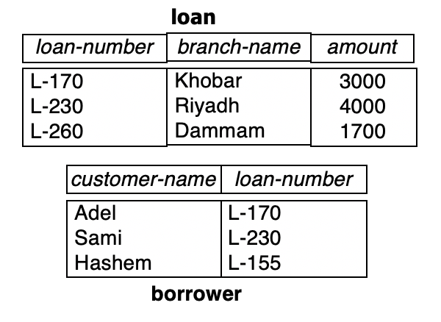
--- Theta Join
It is denoted by: r <r.A θ s.B> s
Where θ = {=, ≠, < , >, ≤, ≥}
loan l.Loan-number = b.loan-number Borrower
Loan-number
Branch-name
amount
Customer-name
Loan-number
L-170
Khobar
3000
Adel
L-170
L-230
Riyadh
4000
Sami
L-230

Slide 56
--- Equijoin
The most common join involves join conditions with equality comparisons, where θ is ‘=‘. This special type of Theta join is called Equijoin.

Slide 57
--- Equijoin
The most common join involves join conditions with equality comparisons, where θ is {=}. This special type of Theta join is called Equijoin.
Its is denoted by: r <r.A = s.B> s
loan loan-number = loan-number Borrower
Loan-number
Branch-name
amount
Customer-name
Loan-number
L-170
Khobar
3000
Adel
L-170
L-230
Riyadh
4000
Sami
L-230
The problem with Equijoin is Pairs of attributes with identical values in evey tuple.

Slide 58
--- Natural-Join Operation
Is denoted by: r s
Let r and s be relations on schemas R and S respectively. Then, r s is a relation on schema R ∪ S obtained as follows:
Consider each pair of tuples t_{r} from r and t_{s} from s.
If t_{r} and t_{s} have the same value on each of the attributes in R ∩ S, add a tuple t to the result, where
t has the same value as t_{r} on r
t has the same value as t_{s} on s
Example:
R = (A, B, C, D)
S = (E, B, D)
Result schema = (A, B, C, D, E)
r s is defined as: ∏_{r.A, r.B, r.C, r.D, s.E} (σ_{r.B = s.B} ∧ _{r.D = s.D} (r x s))

Slide 59
---- Natural Join Operation – Example 1
A
B
C
D
B
D
E
A
B
C
D
E
α
β
γ
α
δ
1
2
4
1
2
α
γ
β
γ
β
a
a
b
a
b
1
3
1
2
3
a
a
a
b
b
α
β
γ
δ
∈
r s
α
α
α
α
δ
1
1
1
1
2
α
α
γ
γ
β
a
a
a
a
b
α
γ
α
γ
δ
r
s
Look for: r.B=s.B ^ r.D = s.D

Slide 60
---- Natural Join – Example 2
loan Borrower
loan-number
branch-name
amount
customer-name
L-170
L-230
Khobar
Riyadh
3000
4000
Adel
Sami
Unlike Equijoin, no pairs of attributes with identical values in evey tuple.

Slide 61
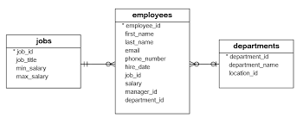
---- Natural Join – Exercise
Show first_name, job_title, and dept_name where max_Salary is > 1000
Notes:
Do natual join on either (emp and dept) or (emp and jobs)
Then do natual join with remaining one
Then do selection to apply predicate for salary > 1000
Then do projection to select first_name, job_title, and dept_name

Slide 62
--- Outer Join
An extension of the join operation that avoids loss of information.
Computes the join and then adds tuples form one relation that does not match tuples in the other relation to the result of the join.
Uses null values:
null signifies that the value is unknown or does not exist
All comparisons involving null are (roughly speaking) false by definition.

Slide 63
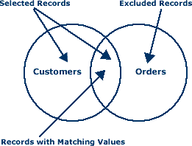
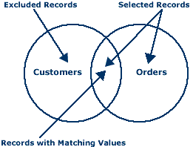
LEFT Vs RIGHT OUTER JOIN

Slide 64
Dangling Tuples in JOIN
Usually, only a subset of tuples of each relation will actually participate in a join.
Tuples of a relation not participating in a join are dangling tuples.
How do we keep dangling tuples in the result of a join?
Use null values to indicate a “no-join” situation.

Slide 65
---- Left Outer Join – Example
Format: R1 R2. Similar to a natural join but keep all dangling tuples of R1.
loan Borrower
loan-number
branch-name
amount
customer-name
L-170
L-230
L-260
Khobar
Riyadh
Dammam
3000
4000
1700
Adel
Sami
null

Slide 66
---- Right Outer Join – Example
Format: R1 R2. Similar to a natural join but keep all dangling tuples of R2.
loan borrower
loan-number
branch-name
amount
customer-name
L-170
L-230
L-155
Khobar
Riyadh
null
3000
4000
null
Adel
Sami
Hashim

Slide 67
---- Full Outer Join – Example
Format: R1 R2. Similar to a natural join but keep all dangling tuples of both R1 & R2.
loan borrower
loan-number
branch-name
amount
customer-name
L-170
L-230
L-260
L-155
Khobar
Riyadh
Dammam
null
3000
4000
1700
null
Adel
Sami
null
Hashim

Slide 68
-- OUTER Join using UNION Operation
Outer Union operation computes the union of two relations if the relations are partially union compatible.
Characteristics:
The list of compatible attributes includes a key for both relations.
Tuples from the component relations with the same key are presented only once in the result and have values for all attributes in the result.
The attributes that are not union compatible from either relation are kept in the result.
Tuples that have no values for these attributes are padded with null values.
OUTER UNION is equivalent to a FULL OUTER JOIN if the join attributes are all the common attributes of the two relations.

Slide 69
--- OUTER UNION Operation: Example
Non-compatible Attributes
Name
SSN
Dept
Advisor
Name
SSN
Dept
Rank
Ali
111
COE
Sami
U
Sami
444
COE
FP
Adel
222
EE
Khaled
Khaled
555
EE
AP
Fahd
333
COE
Sami
Adel
222
EE
TA
Name
SSN
Dept
Advisor
Rank
Ali
111
COE
Sami
null
Adel
222
EE
Khaled
TA
Fahd
333
COE
Sami
null
Sami
444
COE
null
FP
Khaled
555
EE
null
AP

Slide 70
-- Aggregate Functions and Operations
Aggregation function takes a collection of values and returns a single value as a result.
avg: average value min: minimum value max: maximum value sum: sum of values count: number of values
Aggregate operation in relational algebra
_{G1, G2, …, Gn} g _{F1( A1), F2( A2),…, Fn( An)} (E)
E is any relational-algebra expression
G₁, G₂ …, G_{n} is a list of attributes on which to group (can be empty)
Each F_{i} is an aggregate function
Each A_{i} is an attribute name

Slide 71
--- Aggregate Operation – Example 1
A
B
C
∏ _{g sum(c) (r)}
sum-C
α
α
β
β
α
β
β
β
7
7
3
10
27
r

Slide 72
--- Aggregate Operation – Example 2
Relation account grouped by branch-name:
branch-name
account-number
balance
Dammam
Dammam
Khobar
Khobar
Hafuf
A-102
A-201
A-217
A-215
A-222
400
900
750
750
700
_{T = branch-name} g _{sum(balance)} (account)
branch-name
balance
Dammam
Khobar
Hafuf
1300
1500
700

Slide 73
--- Aggregate Functions: Renaming
Result of aggregation does not have a name
Can use rename operation to give it a name
For convenience, we permit renaming as part of aggregate operation
_{branch-name} g _{sum(balance) as sum-balance} (account)

Slide 74
-- Null Values …
It is possible for tuples to have a null value, denoted by null, for some of their attributes
null signifies an unknown value or that a value does not exist.
The result of any arithmetic expression involving null is null.
Aggregate functions simply ignore null values
Is an arbitrary decision. Could have returned null as result instead.
We follow the semantics of SQL in its handling of null values
For duplicate elimination and grouping, null is treated like any other value, and two nulls are assumed to be the same
Alternative: assume each null is different from each other
Both are arbitrary decisions, so we simply follow SQL

Slide 75
… -- Null Values
Comparisons with null values return the special truth value unknown
If false was used instead of unknown, then not (A < 5) would not be equivalent to A >= 5
Three-valued logic using the truth value unknown:
OR: (unknown or true) = true, (unknown or false) = unknown (unknown or unknown) = unknown
AND: (true and unknown) = unknown, (false and unknown) = false, (unknown and unknown) = unknown
NOT: (not unknown) = unknown
In SQL “P is unknown” evaluates to true if predicate P evaluates to unknown
Result of select predicate is treated as false if it evaluates to unknown

Slide 76
- Summary …

Slide 77
… - Summary …

Slide 78
… - Summary
Select σ
Project ∏
Rename ρ
Union ∪
Difference –
Intersection ∩
Division ÷
Assignment ←
Cartesian Product X
Join
Natural Join
Left Outer Join
Right Outer Join
Full Outer Join
Aggregate Function g

Slide 79
- Example Queries …
The following Relations are used for the coming Examples.
branch (branch-name, branch-city, assets)
customer (customer-name, customer-street, customer-only)
account (account-number, branch-name, balance)
loan (loan-number, branch-name, amount)
depositor (customer-name, account-number)
borrower (customer-name, loan-number)

Slide 80
… - Example Queries …
Find all loans of over $1200
T = σ_{amount > 1200} (loan)
Find the loan number for each loan of an amount greater than $1200
T = ∏_{loan-number} (σ_{amount} _{> 1200} (loan))

Slide 81
… - Example Queries …
Find the names of all customers who have a loan, an account, or both, from the bank
T = ∏_{customer-name} (borrower) ∪ ∏_{customer-name} (depositor)
Find the names of all customers who have a loan and an account at bank
T = ∏_{customer-name} (borrower) ∩ ∏_{customer-name} (depositor)

Slide 82
… - Example Queries …
Find the names of all customers who have a loan at the ISB branch.
T = ∏_{customer-name} (σ_{branch-name=“ISB”}
(σborrower.loan-number = loan.loan-number(borrower * loan)))
Find the of all customers who have a loan at the ISB branch but do not have an account at any branch of the bank
T = ∏_{customer-name} (σ_{branch-name = “ISB”}
(σborrower.loan-number = loan.loan-number(borrower * loan))) – ∏_{customer-name}(depositor)

Slide 83
… - Example Queries …
Find the names of all customers who have a loan at the ISB branch.
Query 1 T = ∏_{customer-name}(σ_{branch-name = “ISB”} ( σborrower.loan-number = loan.loan-number(borrower * loan)))
− Query 2
T = ∏_{customer-name}(σloan.loan-number = borrower.loan-number( (σ_{branch-name = “ISB”}(loan)) * borrower))

Slide 84
… - Example Queries …
Find the largest account balance. Rename account relation as d
T = ∏_{balance}(account) - ∏_{account.balance}
(σ_{account.balance < d.balance} (account X ρ_{d} (account)))

Slide 85
… - Example Queries …
Find all customers who have an account from at least the “ISB” and the “LHR” branches.
Query 1
T= ∏CN(σBN=“ISB”(depositor * account)) ∩
∏CN(σBN=“LHR”(depositor * account))
where CN denotes customer-name and BN denotes branch-name.
Query 2
T = ∏customer-name, branch-name (depositor * account) ÷ ρtemp(branch-name) ({(“ISB”), (“LHR”)})

Slide 86
… - Example Queries
Find all customers who have an account at all branches located in ISB city.
T = ∏customer-name, branch-name (depositor * account) ÷ ∏branch-name (σbranch-city = “ISB” (branch))

Slide 87
Useful Links from Stanford
https://www.youtube.com/watch?v=tii7xcFilOA
https://www.youtube.com/watch?v=GkBf2dZAES0&t=336s

